Slide 1
Financial Statement Analysis
December 1, 2022
Wenchen Wang

Slide 2
Financial Statements
Financial Statements
Balance Sheet
Activity Statement
Cash Flow Statement
Help managers and outsiders
Understand the financial condition of an organization
Make decisions about the organization
Compare organization’s financial performance to its peers

Slide 3
Leaning Objective
Financial Analysis Definition
Financial Analysis Process and Steps
Ratio Analysis

Slide 4
Financial Analysis
Tries to answer a series of questions about an organization’s mission, financial stability, and operating results.
Mission
Is the organization meeting its mission?
How is it doing?
Does resource use match goals?
Is the organization effective?
Financial stability and operating results
Liquidity?
Matched maturities for sources & uses of funds?
Is it efficient? (Unit Costs)
Is the cost appropriate?
Other organization-specific considerations?

Slide 5
Financial Analysis Process
The auditor’s opinion
Financial statement and notes
Prepare the appropriate ratios and analyze
When possible, get comparative data
Organization over time
Organization’s peer
Industry
Organize the information and complete the analysis.
Extract as much information as possible
Look for potential problem areas

Slide 6
1. Auditor’s Opinion Letter
1. Auditor’s Opinion Letter
If the financial statements provide a fair representation of the organization’s financial position and the result of its operations
Focus: Whether the financial statements are in compliance with the the accounting principles (GAAP)

Slide 7
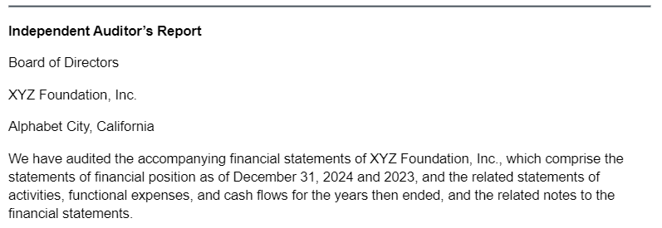
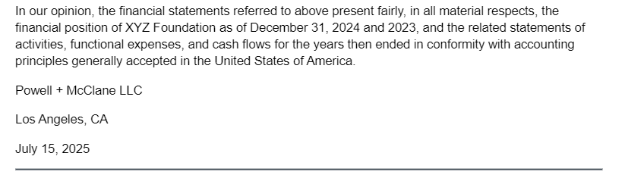
1. Auditor’s Opinion Letter
1. Auditor’s Opinion Letter

Slide 8
2. Financial Statements and Notes
2. Financial Statements & Notes
The notes to the financial statements are an integral part of the statements
Describe the accounting policies used by the organization
Highlight any unusual and material event that occurred during the year
Provide further detail regarding assets and liabilities, and
Provide additional detail as required by GAAP

Slide 9
2. Financial Statements and Notes
2. Financial Statements & Notes
The Meals for the Homeless Notes
In their notes, Meals states that it:
- treats all pledges as restricted until collected,
- uses substantial volunteer labor and recognized $80,000 in 2018 and $72,000 in 2017 as both support and an expense,
- uses LIFO for inventories,
- uses straight-line depreciation,
shows the composition of its investment portfolio.
provided a short description of its operations and the volume of services that it delivered,
- has a defined contribution rather than a defined benefit pension plan,
- described its lease obligations, and
- described the restrictions on its Temporarily Restricted Net Assets.

Slide 10
3. Ratio Analysis
3. Ratio Analysis
Relation / Comparison of two variables (numbers)
Understand the organization’s strengths and weaknesses
Develop a pattern
Focus on potential problems
Help with decision making
Appropriateness
Not all ratios work for all organizations
Meaning of a Ratio
Should it be higher or lower than the average?
One ratio is not sufficient

Slide 11
Get Comparative Data
4. Get Comparative Data
Compare the ratios to:
The organization over time,
Comparable organizations, and
The industry.
Focus on trends:
Should the ratio be higher or lower than average?
Is it better for the ratio to be increasing or decreasing?
It is hard to find exact comparables!

Slide 12
Type of Ratios
Type of Ratios
Common Size Ratios
Liquidity Ratios
Asset Turnover or Efficiency Ratios
Solvency Ratios
Program Service Ratio
Profitability Ratios

Slide 13
Common Size Ratios
Common Size Ratios
Compare all the numbers on a financial statement to one key number
Proportion / Relative Size
Example:
 | Organization A | Organization B
Cash | $10,000 | $100,000
Total Assets
$50,000
$10,000,000
Cash /Total Assets
20%
1%
What does the common size cash ratio mean?
Should common sized cash ratio be high or low?

Slide 14
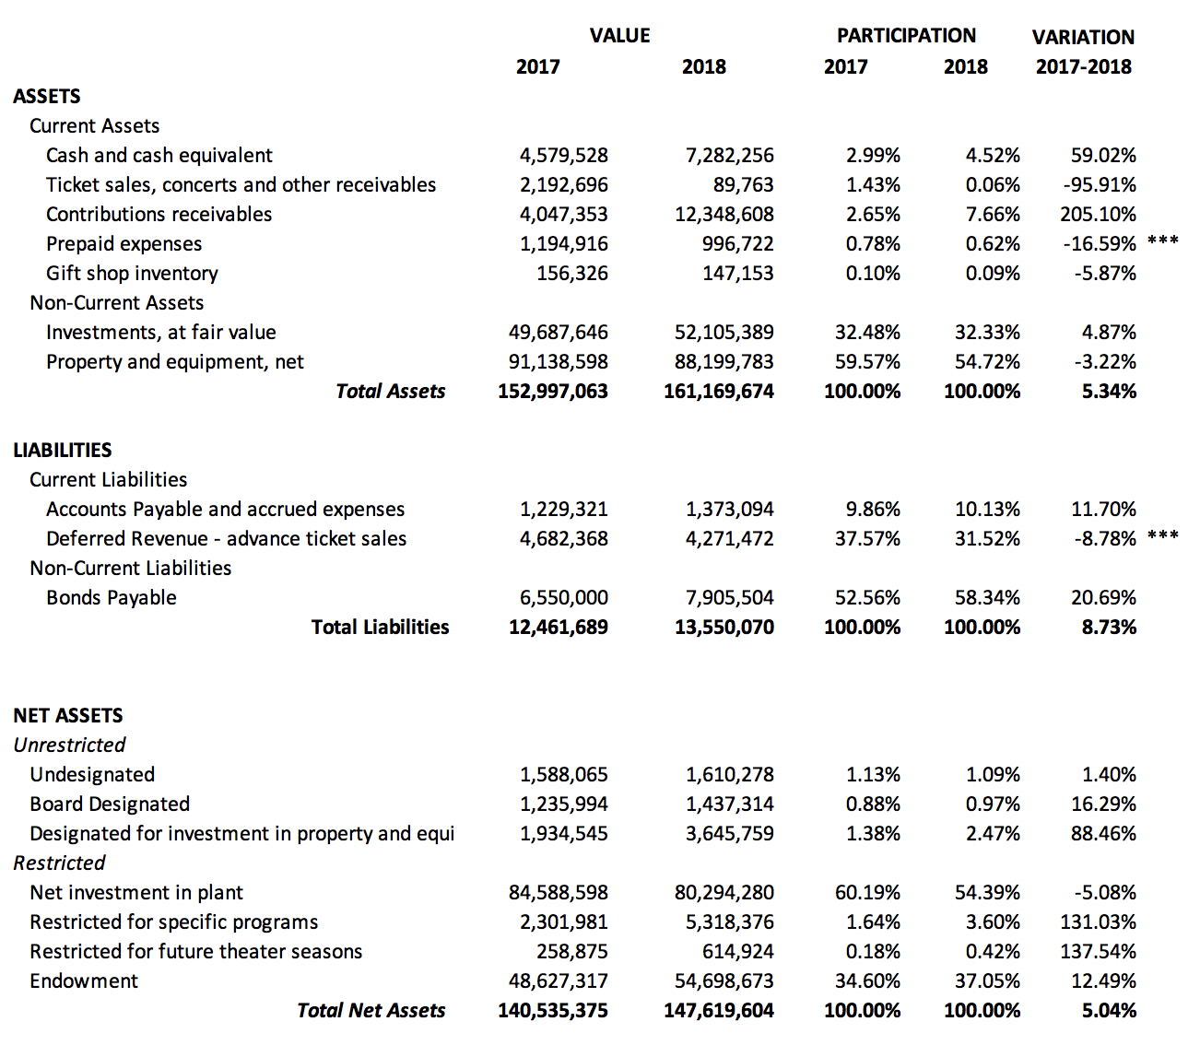
Common Size Ratios

Slide 15
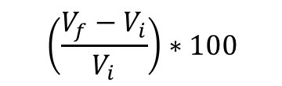
Common Size Ratios
$$\left(\frac{V_{f}−V_{i}}{V_{i}}\right)∗100$$

Slide 16


Liquidity Ratios
Liquidity Ratios
Focus on whether an organization has enough cash and liquid resources to meet near-term obligations
Can we meet our current obligations when they are due?
$$Current Ratio=\frac{Current Assets}{Current Liability}$$
$$Quick Ratio=\frac{Cash+Marketeable Securities+Receivables}{Current Liability}$$
$$Cash Ratio=\frac{Cash+Marketeable Securities}{Current Liability}$$
$$Days of Cash on hand=\frac{Cash+Marketeable Securities}{\left(\frac{Operating expenses −Bad debts −Depreciation}{365}\right)}$$
Should liquid ratios be high or low?

Slide 17
Common Size Ratios
Current Ratios
The current ratio compares current assets with its current liabilities.
Example:
The current assets as shown in the balance sheet at the end of 2021 for Organization A is $81,100, and the current liabilities is $34,000.
$$Current Ratio=\frac{Current Asset}{Current Liabilities}=\frac{81100}{34000}=2.4$$
Rule of Thumb: 2 to 1
Trend should be: UP
Ratio should be: ABOVE THE MEDIAN
What does a current ratio of 1.0 mean?
Should current ratio be high or low?

Slide 18
Common Size Ratios
Quick Ratios
The quick ratio excludes all assets except cash, marketable securities, and receivables in making the comparison with current liabilities. Can we meet our current obligations out of liquid resources
$$Quick Ratio=\frac{Cash+Marketeable Securities+Receivables}{Current Liability}$$
Should quick ratio be high or low?
Rule of Thumb: 1 to 1
Trend should be: UP
Ratio should be: ABOVE THE MEDIAN

Slide 19

Common Size Ratios
Cash Ratios/Days of Cash On Hand
The cash ratio is even more stringent. Its purpose is to assess how long the organization could meet its typical daily expenses using just the cash (and near cash assets) on hand. how long could the organization meet its cash outflows using just the resources on hand
$$Cash Ratio=\frac{Cash+Marketeable Securities}{Current Liability}$$
$$Days of Cash on hand=\frac{Cash+Marketeable Securities}{\left(\frac{Operating expenses −Bad debts −Depreciation}{365}\right)}$$
Should cash ratio be high or low?
Rule of Thumb: None
Trend should be: UP
Ratio should be: ABOVE THE MEDIAN

Slide 20


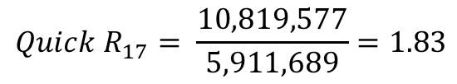
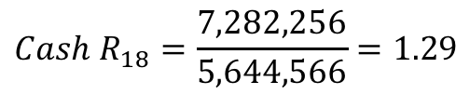
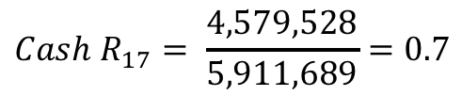

$${Cash R}_{17}= \frac{4,579,528}{5,911,689}=0.7$$
$${Cash R}_{18}=\frac{7,282,256}{5,644,566}=1.29$$
$${Quick R}_{17}= \frac{10,819,577}{5,911,689}=1.83$$
$${Quick R}_{18}= 3.49$$
$${Current R}_{17}=\frac{12,170,819}{5,911,689}=2.06$$
$${Current R}_{18}=3.70$$

Slide 21
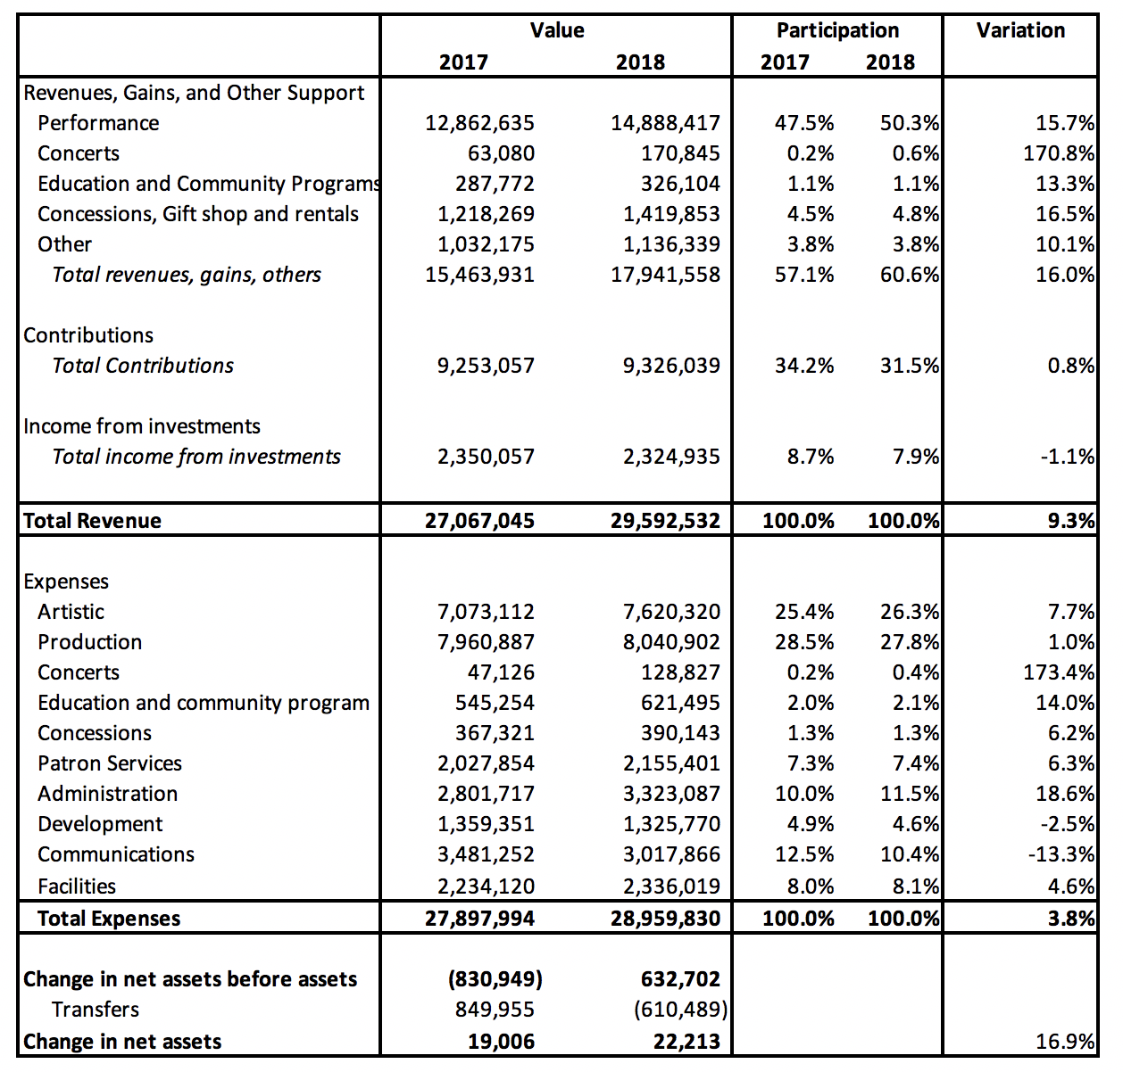
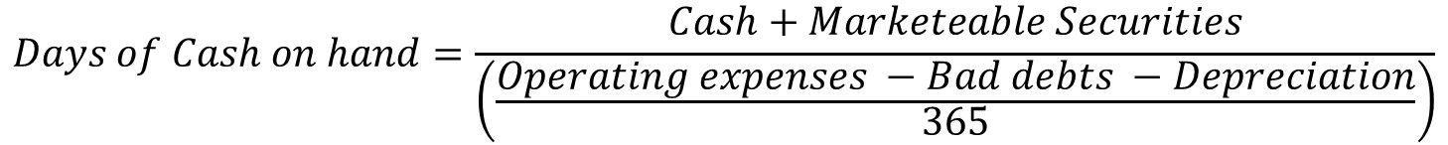
Liquidity Ratios
$$Days of Cash on hand=\frac{Cash+Marketeable Securities}{\left(\frac{Operating expenses −Bad debts −Depreciation}{365}\right)}$$
 | 2017 | 2018
Days of cash on hand | 59.92 | 91.78

Slide 22

Asset Turnover Ratios (Efficiency Ratios)
They relate income statements (flows) to balance sheets (stocks).
Account Receivables
Receivables Turnover$=\frac{Net Revenue and Support}{Accounts Receivable}$
Revenue and support on credit (minus those in cash)
Sometimes Average receivables: ((beginning + ending receivables) /2)
Rule of Thumb: None
Trend should be: UP
Ratio should be: ABOVE THE MEDIAN
Collection of receivables is as if we collected and generated receivables X times in a year
Average Collection Period$=\frac{365}{Receivables Turnover}$
X days to collect a receivable
Rule of Thumb: None
Trend should be: DOWN
Ratio should be: BELOW THE MEDIAN
$$Between 30 and 60 days$$

Slide 23
 | 2017 | 2018
Receivable turnover | 3.96 | 2.19
Average Collection Period | 92.15 | 166.55

Slide 24

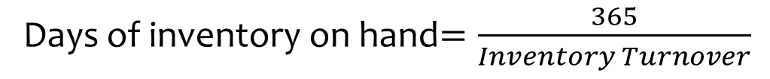
Asset Turnover Ratio (Efficiency Ratios)
Asset Turnover Ratios (Efficiency Ratios)
Inventory
In Activity Statement
Inventory Turnover$=\frac{Cost of Inventory}{Inventory}$
Inventory balance (In Balance Sheet)
Sometimes Average inventory: ((beginning + ending inventory) /2)
Rule of Thumb: None
Trend should be: UP
Ratio should be: ABOVE THE MEDIAN
Inventory turns over X times a year
Days of inventory on hand$=\frac{365}{Inventory Turnover}$
X days we had inventory before it was consumed/used
Rule of Thumb: None
Trend should be: DOWN
Ratio should be: BELOW THE MEDIAN

Slide 25
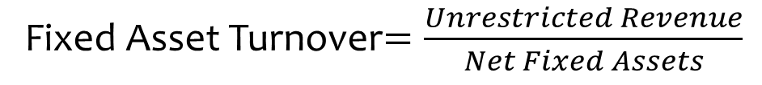
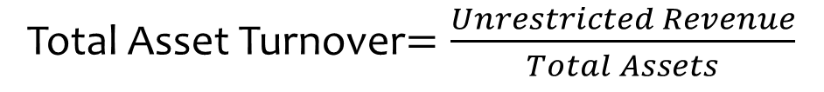
Asset Turnover Ratio (Efficiency Ratios)
Asset Turnover Ratios (Efficiency Ratios)
Fixed Asset
Fixed Asset Turnover$=\frac{Unrestricted Revenue}{Net Fixed Assets}$
$X of revenue is generated by each dollar invested in fixed assets
Rule of Thumb: None
Trend should be: UP
Ratio should be: ABOVE THE MEDIAN
Total Asset Turnover$=\frac{Unrestricted Revenue}{Total Assets}$
$X of revenue is generated for each dollar of total assets
Rule of Thumb: None
Trend should be: UP
Ratio should be: ABOVE THE MEDIAN

Slide 26
Solvency Ratio
Solvency Ratio
Debt is a double-edged sword.
Debt allows the organization to undertake programs or provide services that they otherwise could not do
The greater the debt, the riskier the organization becomes
Solvency Ratios
Leverage ratios: Examine the use of debt to finance acquisition of assets
Coverage ratios: Examine the capacity to make payments

Slide 27
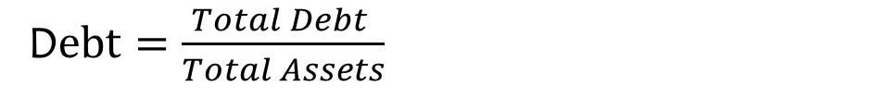


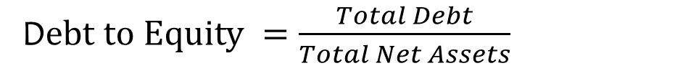
Solvency Ratio
Solvency Ratio
Leverage
Rule of Thumb: 0.5 or less
Trend should be: DOWN
Ratio should be: BELOW THE MEDIAN
D$ebt=\frac{Total Debt }{Total Assets}$
$$≤0.5$$
D$ebt to Equity =\frac{Total Debt}{Total Net Assets}$
Rule of Thumb: 1 or less
Trend should be: DOWN
Ratio should be: BELOW THE MEDIAN
$$≤1$$
 | 2017 | 2018
Debt | 0.081 | 0.084
Debt to Equity | 0.089 | 0.092

Slide 28

Solvency Ratio
Solvency Ratio
Coverage
Times interest Earned$=\frac{Increase in Unrestrictred Net Assets+Interest Expense}{Interest Expense}$
$$≥1$$
Example
Revenue $800
Interest Expense $200
Other Expenses $400
Increase in Net Assets $200
What is time interest earned?
Rule of Thumb: At least 1 to 1
Trend should be: UP
Ratio should be: ABOVE THE MEDIAN

Slide 29

Solvency Ratio
Solvency Ratio
Coverage
Cash Flow Coverage$=\frac{Cash from Operations+Interest+Rent}{Interest+Rent+Debt Payments}$
$$≥1$$
Rule of Thumb: At least 1 to 1
Trend should be: UP
Ratio should be: ABOVE THE MEDIAN

Slide 30
Program Service Ratio
Program Service Ratio
What portion of spending goes directly into program services
Program Service Ratio $=\frac{Program Service Expenses}{Total Expenses}$
Rule of Thumb: None
Trend should be: UP
Ratio should be: ABOVE THE MEDIAN

Slide 31



Profitability Ratio
Profitability Ratios
$$Operating Margin=\frac{Increase in Unrestricted Net Assets}{Total Unrestricted Revenues}$$
For all profitability ratios:
Rule of Thumb: None
Trend should be: Judgment Call
Ratio should be: Judgment Call
$$Total Margin=\frac{Increase in Net Assets}{Total Unrestricted Revenues}$$
 | 2018
Operating Margin | 0.07
Total margin | 0.26
ROA | 0.046
RONA | 0.048
$$ROA=\frac{Increase in Net Assets}{Total Assets}$$
$$RONA=\frac{Increase in Net Assets}{Net Assets}$$

Slide 33
Complete the Analysis
5. Complete the Analysis
Identify red flags in the data: Potential problems
When you think that you see a problem:
Ask why it is happening
Find data to either support or refute your beliefs
Organize the data to find patterns
Periodically step back and summarize what you have found
Focus your final analysis on the big picture. Don't get caught up in irrelevant details!

